Slide 1
Design and Analysis of Algorithms (22CS2402)
Prof.Nandini K
Assistant Professor
Department of Computer Science and Engineering
Dayananda Sagar University, Harohalli, Karnataka.
Email-id: nandini-cse@dsu.edu.in
Faculty Cabin: A539

Slide 2
MODULE 1
Introduction: What is an Algorithm? Fundamentals of Algorithmic Problem Solving. Text Book-1: Chapter 1: 1.1 to 1.2
Fundamentals of The Algorithms Efficiency: Analysis Framework, Asymptotic Notations and Standard notations and common functions.
Text Book-2: Chapter 3: 3.1, 3.2
Mathematical Analysis of Non-recursive and Recursive Algorithms.
Text Book-1: Chapter 2: 2.1, 2.3, 2.4
1. Anany Levitin, “Introduction to the Design & Analysis of Algorithms”, 2nd Edition, Pearson Education, 2011.
2. Thomas H. Cormen, Charles E.Leiserson, Ronald L. Rivest, Clifford Stein, “Introduction to Algorithms”, 3rd Edition, PHI, 2014.

Slide 3
ALGORITHM
A sequence of Unambiguous instructions for solving a problem, i.e for obtaining the required output for any legitimate input in a finite amount of time.

Slide 4
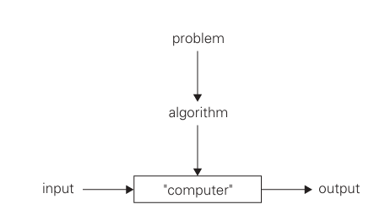
NOTATION OF THE ALGORITHM

Slide 5
Special Features of Algorithms
Non-ambiguity.
Range of Inputs
The same algorithm can be represented in different ways.
Several algorithms for solving the same problem.
Different algorithms with different speeds.

Slide 6
Find the GCD(m , n)
Method 1:Descriptive Algorithm
Middle-school Procedure for computing gcd(m, n)
Step 1: Find the prime factors of m.
Step 2: Find the prime factors of n.
Step 3: Identify all the common factors in the two prime expansions found in step 1 and step2.(If p is a common factors occurring Pm and Pn times in m and n, respectively, it should be repeated min{Pm and Pn} times).
Step 4: Compute the product of all the common factors and return it as the greatest common divisor of the numbers given.

Slide 7
GCD using Euclid’s Method
GCD using Euclid’s Method
gcd(m, n)=gcd(n, m mod n)
Find:
GCD(124,12)
GCD(160,15)
GCD(338,22)
GCD(150,8)

Slide 8
Find the GCD(m , n)
Method 2: Descriptive Algorithm
Euclid’s algorithm for computing gcd(m, n)
Step1: if n=0, return the value of m as the answer and stop; otherwise, Proceed to Step 2.
Step 2: Divide m by n and assign the value of the remainder to r.
Step 3: Assign the value of n to m and the value of r to n. Go to Step1.

Slide 9
Find the GCD(m , n)
Method 2: Pseudocode Representation
ALGORITHM Euclid(m, n)
// Computes gcd(m, n) by Euclid’s algorithm
//Input: Two Non-negative, not-both-zero integers m and n.
//Output: Greatest common divisor of m and n
while n ≠ 0 do
r ← m mod n
m← n
n← r
return m

Slide 10
Find the set of all Prime numbers
Method 1: Middle school level
Find Set of all Prime Numbers within 25.

Slide 11
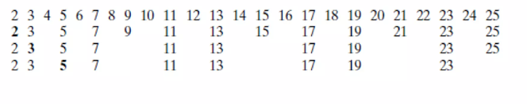
Find the set of all prime numbers
Method 2: Sieve of Eratosthenes
Find Set of ALL Prime Numbers within 25

Slide 12
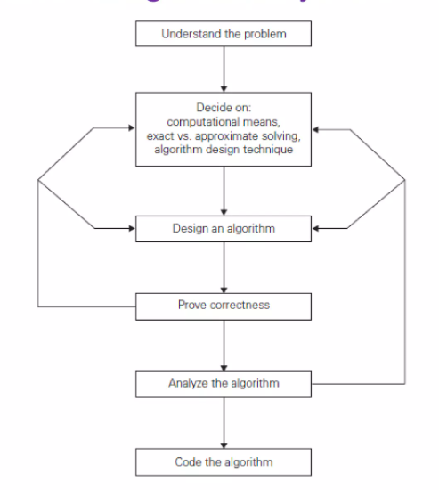
Fundamentals of Algorithmic Problem Solving/ Algorithm Design & Analysis Process

Slide 13
Fundamentals of Algorithmic Problem Solving/ Algorithm Design & Analysis Process
Understanding the problem
Read the problem’s description carefully
Use already known algorithms
All possible input instances
Ascertaining the capabilities of computational device
Random Access Machine
Sequential Algorithms
Parallel Algorithms
Dependent on the problems

Slide 14
Fundamentals of Algorithmic Problem Solving/ Algorithm Design & Analysis Process
3. Choosing between exact and approximate problem solving
Exact Algorithms
Approximation Algorithms
4. Algorithm design techniques
5. Designing an algorithm and Data structures
Algorithm + Data Structures = Programs
6. Methods of Specifying an algorithm
Natural Language
Pseudocode
7. Proving an algorithm’s Correctness

Slide 15
Fundamentals of Algorithmic Problem Solving/ Algorithm Design & Analysis Process
8. Analysing an algorithm
Time Efficiency
Space Efficiency
Simplicity
Generality
9. Coding an Algorithm

Slide 16
ALGORITHM ANALYSIS
Algorithm analysis is a study that provides theoretical estimation of the resources required by an algorithm to solve a specific computational problem.
Efficiency of the algorithm is measured in terms of time and space complexity.
Algorithm analysis does not give exact values for time and space complexity , Algorithm analysis does not give exact values for time and space complexity ,however it gives approximate estimate which can be used to study the behavior of algorithms.
however it gives approximate estimate which can be used to study the behavior of algorithms.

Slide 17
Analysis Framework
Need for Analysis
Criteria to analyse an algorithm
Time Complexity
Space Complexity
Orders of Growth
Worst-case, Best-case and Average-case analysis

Slide 18
NEED FOR ANALYSIS
Software or any application especially those involving large dataset cannot be developed on trail and error basis.
Programmers cannot waste time and resources in trying out all possible available alternatives to solve the problem at hand.
Generally there are multiple approaches/methods/algorithms to solve a problem . Algorithm analysis filters out the best/optimal approach of all the available approaches.
Hence care must be taken at design phase in analyzing and filtering out the best suitable algorithm that solves the problem at hand.

Slide 19
CRITERIA TO ANALYZE AN ALGORITHM
1.TIME COMPLEXITY: How fast an algorithm executes
2.SPACE COMPLEXITY: Amount of memory space required by an algorithm to work
3.NETWORK COMMUNICATION: The applications that are web based/internet based/cloud based then the amount of data transferred or network also plays an important role.
4.POWER CONSUMPTION
5.CPU REGISTERS CONSUMED: if the algorithms are written for device drivers or system software.

Slide 20
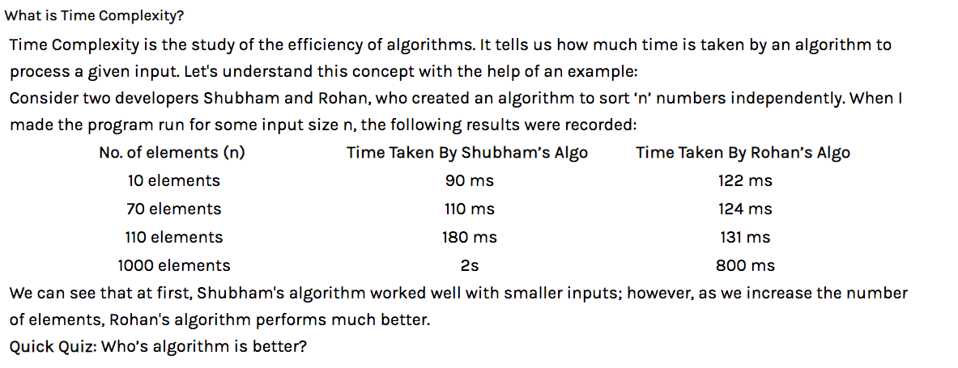
TIME COMPLEXITY

Slide 21
TIME COMPLEXITY
Note: Time complexity!=Time taken
Time complexity is a mathematical function that define the relationship about how time grows as the input grows.
Time efficiency is analyzed by determining the number of repetitions of the basic operation as a function of input size.
Basic operation is the core operation like:
assignment , comparing 2 values, swapping 2 numbers, performing arithmetic operation etc. Basic operation generally resides in a loop.

Slide 22
METHODS TO COMPUTE THE STEP COUNT
Time efficiency is analyzed by determining the number of repetitions of the basic operation as a function of input size.
Basic operation is the core operation like:
assignment , comparing 2 values, swapping 2 numbers, performing arithmetic operation etc. Basic operation generally resides in a loop.

Slide 23
Problems-Time Complexity
Problem1:
For(i=0; i<n; i++)
{
printf(“Hello”);
}
F(n)=n+1+n=2n+1
F(n)=o(n)

Slide 24
METHODS
Method 1: Introduce variable count into programs
Introduce a global variable “count”, which is initialized to zero. So each time a statement in the program is executed, count is incremented by the step count of that statement.
Method 2: Tabular method/Frequency count method/Step count method.
Determine the total number of steps contributed by each statement step per execution × frequency
add up the contribution of all statements.

Slide 25
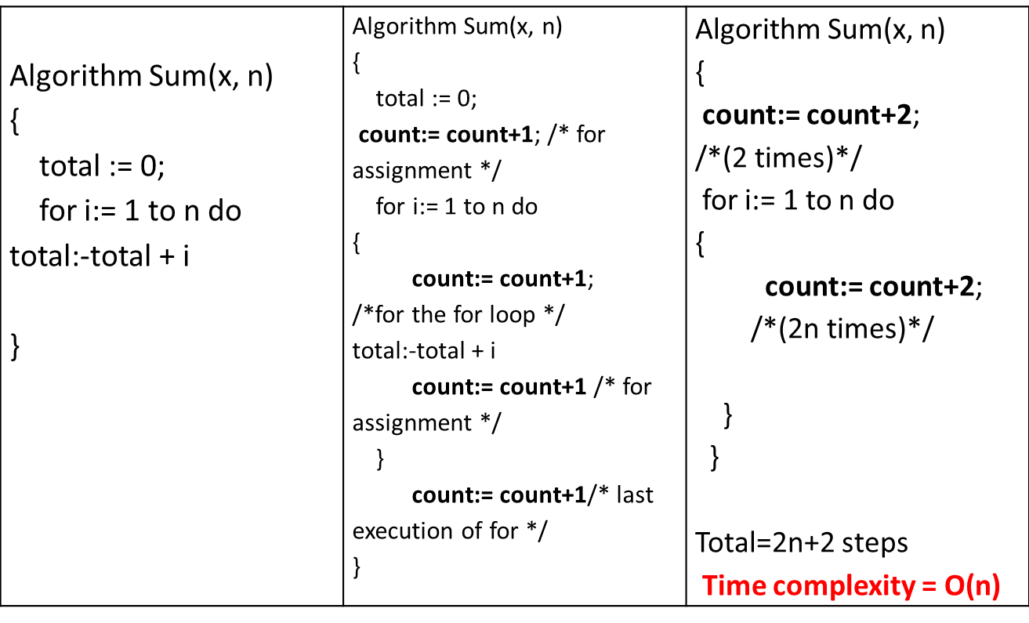
METHOD 1: INTRODUCE VARIABLE COUNT INTO PROGRAMS
Example 1: Find the time complexity for sum of n elements using count variable method.

Slide 26
Method 2: Tabular method
Example 1: Find the time complexity for sum of n elements using Tabular method
Statement | S/e | Frequency | Total steps
1. Algorithm Sum(a, n) | 0 | - | 0
2. { | 0 | - | 0
3. s:=0; | 1 | 1 | 1
4. for i:=1 to n do | 1 | n+1 | n+1
5. s:=s+a[i]; | 1 | n | n
6. return s; | 1 | 1 | 1
7. } | 0 | - | 0
Total |  |  | 2n+3 steps
Time complexity = O(n)

Slide 27
Link for more problems on time complexity
https://drive.google.com/file/d/1iztF4UFGIzp3Yo4O67eJlzORcgVip_3G/view?usp=sharing

Slide 28
Space Complexity
Space Efficiency
The amount of memory required to run the program completely and efficiently.
Components that affect space are:
Program Space → Storing machine program generated by compiler or assembler.
Data Space → Store constants, variables etc.
Stack Space → Store the return address along with parameters that are passed to function, local variables etc.

Slide 29
Space Complexity S(P)=C+S_{P}
FIXED SPACE REQUIREMENTS (C) Independent of the characteristics of the inputs and outputs
instruction space
space for simple variables, fixed-size structured variable, constants
VARIABLE SPACE REQUIREMENTS (SP(I))
depend on the instance characteristic I
number, size, values of inputs and outputs associated with I.
recursive stack space, formal parameters, local variables, return address.

Slide 30
REASONS FOR STUDYING SPACE COMPLEXITY
1.If the program is to run on multi-user system , it may be required to specify the amount of memory to be allowed to the program.
2.To know in advance that whether sufficient memory is available to run the program.
3.There may be several possible solutions with different space requirements.
NOTE: Instance characteristics (S_{p}) varies from problem to problem , so during analyzing the space complexity the sole concentration is on analyzing S_{p.}

Slide 31
PROBLEMS ON SPACE COMPLEXITY
Example: 1
Algorithm ADD ( float [], int n)
{
sum = 0.0;
for i=1 to n do
sum=sum+X[i];
return sum;
}
Here, at least n words since X must be large enough to hold the n elements to be summed. Here the problem instances are characterized by n, the number of elements to be summed. So,
S(ADD) =3+n
3-one each for n, I and sum .
Where n- is for array X[].
Space complexity is O(n).

Slide 32
PROBLEMS ON SPACE COMPLEXITY
Example 2
Algorithm factorial (int n)
{
if (n == 0)
return 1;
else.
return(n * factorial(n-1));
}
Space complexity is O(n).

Slide 33
Order of Growth
The relative performance of an algorithms depends on input data size N.
The order of growth is normally determined for larger values of n for the following reasons:
The behavior of an algorithm changes as the value of n increases.
In real time applications large values of n is encountered.
If there are multiple input parameters, we will try to reduce them to a single parameter, expressing some parameters in terms of the selected parameter.
Between two algorithms it is considered that the one having a smaller order of growth is more efficient.
However, this is true only for large enough input sizes

Slide 34
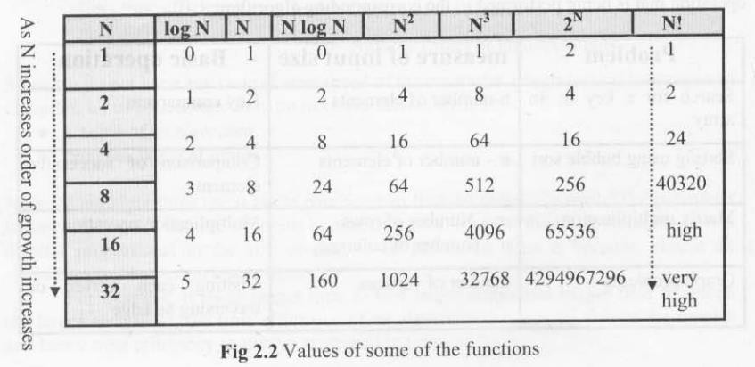
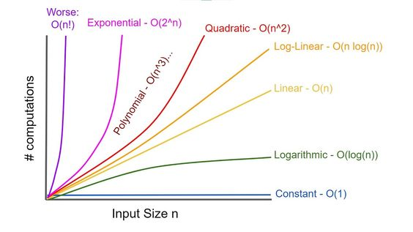
Rate of growth of function

Slide 35
Sequential Search Algorithm
Algorithm sequential_search(A,n,key)
i=0
while i<n && a[i]!=key i=i+1
if i<n
return i
else
return -1

Slide 36
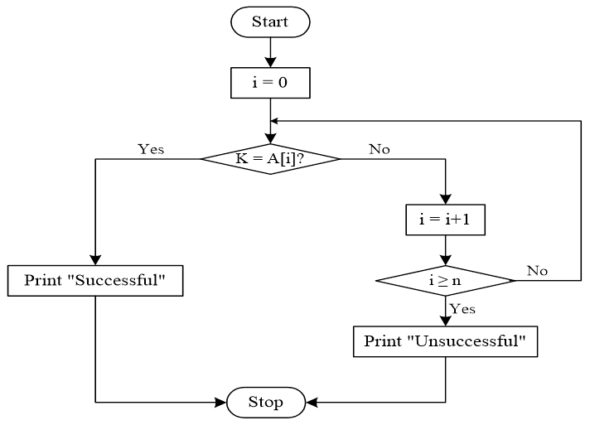
LINEAR SEARCH
Linear search is a sequential searching algorithm where we start from one end and check every element of the list until the desired element is found. It is the simplest searching algorithm.

Slide 37
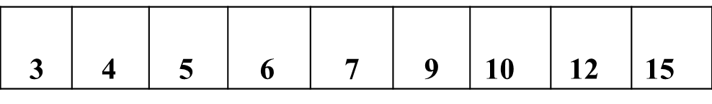
LINEAR SEARCH
BEST CASE: If we want to search an element 3, whether it is present in the array or not. First, A(1) is compared with 3, match occurs. So the number of comparisons is only one. Time complexity is O(1)
AVERAGE CASE: If we want to search an element 7, whether it is present in the array or not.
First, A(1) is compared with 7 i.e., (3=7), no match occurs.
Next, compare A(2) and 7, no match occurs. Compare A(3) and A(4) with 7, no match occurs. Up to now 4 comparisons takes place.
Now compare A(5) and 7 (i.e., 7=7), so match occurs. The number of comparisons is 5
Note: If there are n elements, then we require n/2 comparisons.
. . Time complexity is O (n/2) = O(n) (we neglect constant)

Slide 38
LINEAR SEARCH
WORST CASE: If we want to search an element 15, whether it is present in the array or not.
First, A(1) is compared with 15 (i.e., 3=15), no match occurs.
Continue this process until either element is found or the list is exhausted.
The element is found at 9th comparison.
So number of comparisons are 9.
Time complexity is O(n)
If the element is not found in array, then we have to search entire array, so it comes under worst case.

Slide 39
Asymptotic Notations
The order of growth can be expressed using two methods:
Order of growth using asymptotic notations.
Order of growth using limits.
Asymptotic Behavior of a Function
Asymptotic notations are the notations using which two algorithms can be compared with respect to
efficiency based on the order of growth of an algorithm’s basic operation.
The different types of asymptotic notations are:
O (Big Oh)
Ω (Big Omega)
Θ (Big Theta)

Slide 40
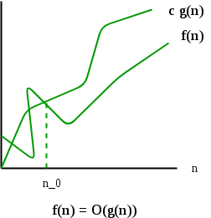
BIG-OH(O)
Big O specifically describes the worst case scenario.
It represents the upper bound running time complexity of an algorithm.
Big-oh is the formal method of expressing the upper bound of an algorithm's running time. It is the measure of the longest amount of time.
The function f (n) = O (g (n)) if and only if there exist positive constant c > 0and n₀ such that
f(n) ≤ c*g(n) ∀n ≥ n₀ and n₀>=1

Slide 41
EXAMPLE
O(g(n)) = {f(n) : ∃ positive constants c and n₀, such that ∀n ≥ n₀, we have f(n) ≤ cg(n) }
Ex: f(n) = 2n+3, g(n)=2n+3
2n+3 ≤ 2n+3n ∀n ≥ n0
≤ 5n n ≥ 1
∴ f(n) = O(n)
c = 5, n0=1, g(n) = n

Slide 42
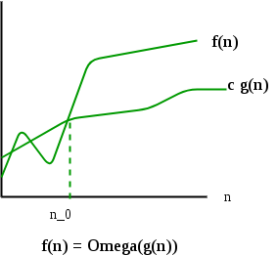
BIG-OMEGA(Ω)
Omega is the formal method of expressing the lower bound of an algorithm's running time.
It is the measure of the smallest amount of time.
The function f(n) = Ω(g (n)) if and only if there exist positive constant c>=1 and n₀ >1such that f(n) ≥ c*g(n) ∀n ≥ n0

Slide 43
EXAMPLE
Ω(g(n)) = {f(n) : ∃ positive constants c and n₀, such that ∀n ≥ n₀, we have f(n) ≥ cg(n) }
Ex: f(n) = 2n+3, g(n)=1n
2n+3 ≥ 1*n ∀n ≥ n0
≥ 1n ∀ n ≥ 1
∴ f(n) = Ω(g(n))
c = 1, n0=1, g(n) = n

Slide 44
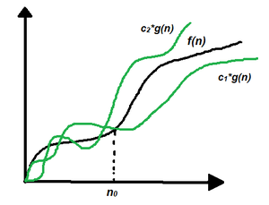
BIG THETA(Θ -notation)
Theta is the formal method of expressing the average bound of an algorithm's running time.
It is the measure of the average amount of time.
The function f (n) = Θ(g (n)) if and only if there exist positive constants c1, c2 and n₀ such that c1* g(n) ≤ f(n) ≤ c2 *g(n) ∀n ≥ n₀

Slide 45
EXAMPLE
Θ(g(n)) = {f(n) : ∃ positive constants c1, c2, and n0, such that ∀n ≥ n₀, c1g(n) ≤ f(n) ≤ c2g(n)}
Ex: f(n) = 2n+3
1n ≤ 2n+3 ≤ 5n

Slide 46
RELATIONS BETWEEN Θ, Ω, O
Theorem :
For any two functions g(n) and f(n), f(n) = Θ(g(n)) iff f(n) = O(g(n)) and f(n) = Ω(g(n)).
I.e., Θ(g(n)) = O(g(n)) ∩ Ω(g(n))
In practice, asymptotically tight bounds are obtained from asymptotic upper and lower bounds.

Slide 47

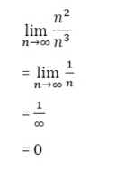
LITTLE OH NOTATION
1.If f(n) = n² and g(n) = n³ then check whether f(n) = o(g(n)) or not.
Solution:
For f(n)=o(g(n))
The result is 0, and it satisfies the equation mentioned above.
So we can say that f(n) = o(g(n)).

Slide 48
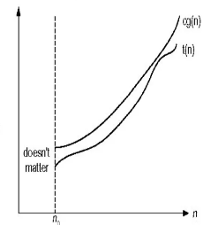
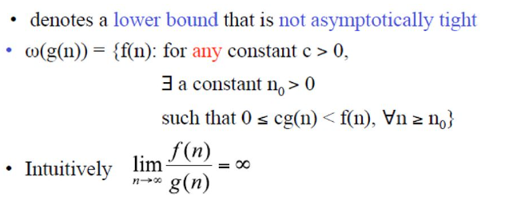
LITTLE ω NOTATIONS

Slide 49
USING THE ORDER TO ESTIMATE RUN - TIME
Efficiency: The efficiency of an algorithm is a measure of its run time. This is proportional to operation.
Size: The size is a measure of the complexity.(Usually the no of items in the list or input size)
Order: The order of an algorithm is a measure of the efficiency as a function of the size.

Slide 50
PROBLEMS ON EFFICIENCY
Solution:
E ∝n² (E is proportional to n²)
To remove proportionality use a constant K, so
E=K.n² (E=2, n=15)
2=K(15)²
2=K(225)
K=2/225
If n=150
E=(2/225)(1502)
E =200 sec
Problem 1:
A computer is programmed with an algorithm of Quadratic order, it takes 2 seconds to solve a problem of size 15. Estimate how long would it take to solve a problem of size 150.

Slide 51
PROBLEMS ON EFFICIENCY
Problem 2:
A computer is programmed with an algorithm of 2^{n} order, it takes 2 seconds to solve a problem of size 15. Estimate how long would it take to solve a problem of size 150.

Slide 52
Solution:
E ∝2n (E is proportional to 2n)
To remove proportionality use a constant K, so
E=K2^{n} (E=2, n=15)
2=K(2¹⁵)
K=1/2¹⁴
If n=150
E=(1/2¹⁴)(2¹⁵⁰)
E =2¹³⁶ seconds

Slide 53
PROBLEMS ON EFFICIENCY
Problem 3:
An algorithm has an order of n⁴ and it takes 3750 seconds to solve a problem of size 5.
Estimate time taken to solve a problem of size 8.

Slide 54
Solution:
E ∝n⁴ (E is proportional to n⁴)
To remove proportionality use a constant K, so
E=Kn⁴ (E=3750, n=5)
3750=K(5⁴)
K=6
If n=8
E=6(8⁴)
E =24576 seconds

Slide 55
PROBLEMS ON EFFICIENCY
Problem 4:
An algorithm has an order n and it takes 30 seconds to solve a problem of size 3. Estimate time taken to solve a problem of size 6.

Slide 56
Solution:
E ∝n (E is proportional to n)
To remove proportionality use a constant K, so
E=Kn (E=30, n=3)
30=K(3)
K=10
If n=6
E=10(6)
E =60 seconds

Slide 57
PROBLEMS ON EFFICIENCY
Problem 5: An algorithm has order 3n and it takes 324seconds to solve a problem of size 4. Estimate the time taken to solve a problem of size 11.
Solution:708588 Seconds
Example 6: An algorithm has order 5n and it takes 200seconds to solve a problem of size 2. Estimate the time taken to solve a problem of size 7.
Solution: 625000 Seconds
Example 7: An algorithm has order 7n and it takes 14seconds to solve a problem of size 1. Estimate the time taken to solve a problem of size 9.
Solution: 80707214 Seconds

Slide 58
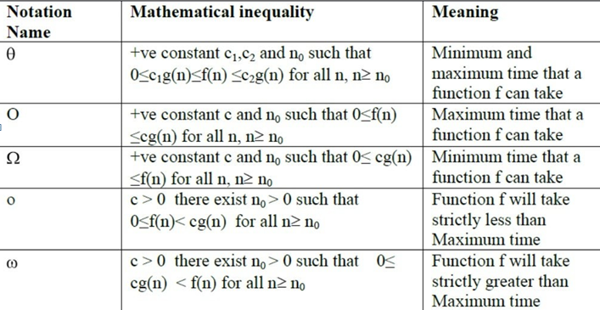
SUMMARY OF ASYMPTOTIC NOTATIONS

Slide 59
PROBLEMS ON ASYMPTOTIC NOTATIONS REFER CLASS NOTES.
Link for scanned notes:
https://drive.google.com/file/d/1Z_lPs_bJC7aTGdjgCGEXPvkUANAzb10R/view?usp=sharing

Slide 60
Mathematical Analysis for Non-Recursive Algorithms
Decide on a parameter indicating an input’s size.
Identify the basic operation.
Does C(n) depends only on n or does it also depend on type of input?
Set up sum expressing the # of times basic operation is executed.
Find closed form for the sum or at least establish its order of growth

Slide 61
Problems
Maximum of n elements
Element uniqueness problem
Matrix multiplication
Linear Search

Slide 62
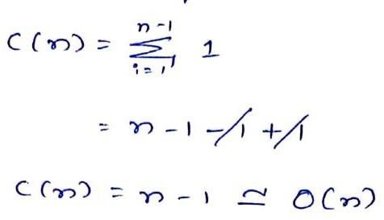
1. Maximum of n elements
ALGORITHM MaxElement(A[0..n-1])
maxval <- A[0]
for i ←1 to n-1 do
if A[i] > maxval
maxval ← A[i]
return maxval
Input size: n
Basic operation: Comparison (>)

Slide 63
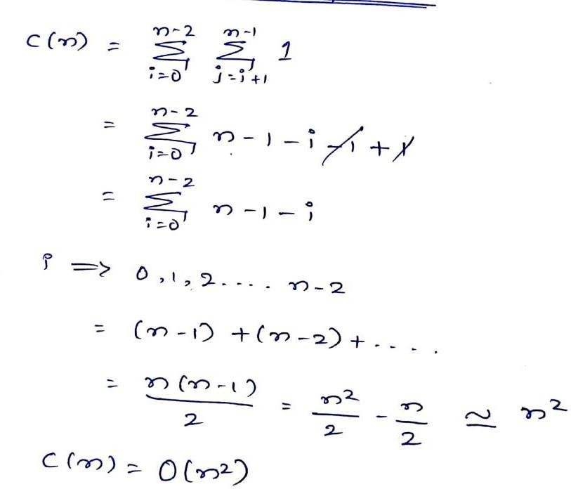
2. Element uniqueness problem
Input size: n
Basic operation: Comparison (=)
ALGORITHM UniqueElements(A[0..n-1])
for i ← 0 to n-2 do
for j ← i+1 to n-1 do
if A[i] = A[j]
return false
return true

Slide 64
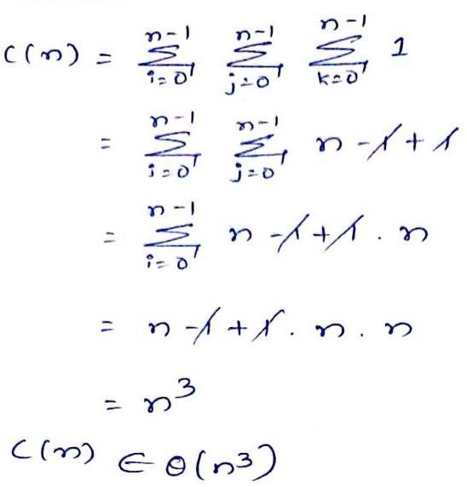
3. Matrix Multiplication
ALGORITHM MatrixMultiplication(A[0..n-1, 0..n-1], B[0..n-1, 0..n-1])
for i ← 0 to n-1 do
for j ← 0 to n-1 do
C[i, j] = 0.0
for k ← 0 to n-1 do
C[i, j] = C[i, j] + A[i, k]×B[k, j]
return C
Input size: n
Basic operation: Multiplication (*)

Slide 65
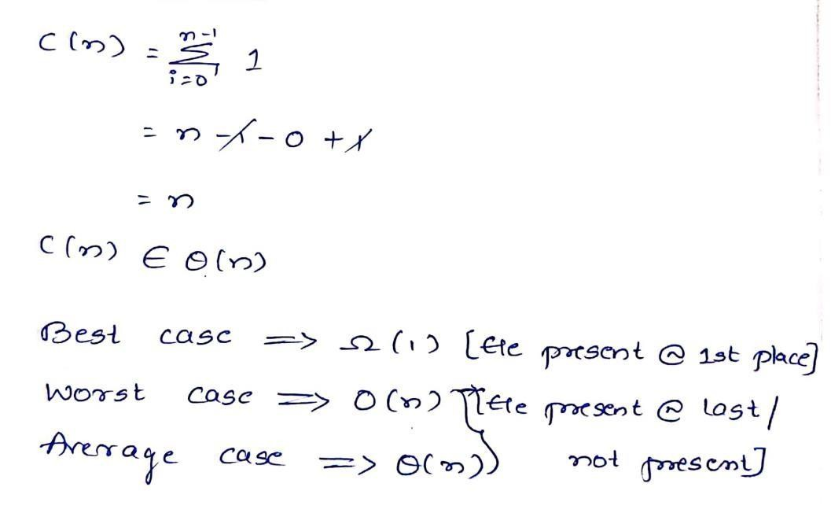
4. Linear Search
ALGORITHM LinearSearch(key, A[0..n-1], n)
for i ← 0 to n-1 do
if(key==a[i])
return i;
return -1
Input size: n
Basic operation: Comparison (==)

Slide 66
Mathematical Analysis for Recursive Algorithms
Decide on a parameter indicating an input’s size
Identify the basic operation
Does C(n) depends only on n or does it also depend on type of input?
Set up Recurrence relation expressing the number of of times basic operation is executed.
Solve the recurrence relation and establish its order of growth

Slide 67
Types of Recursion
Direct Recursion: A recursive function that invokes itself is said to have direct recursion.
Indirect Recursion: A function contains a call to another function which in turn calls another
function which in turn calls another function and so on and eventually calls the first function is
called indirect recursion.

Slide 68
Basic Terms
Base Case: The base case is a way to return without making a recursive call.
General Case: The recursive function in the program is known as general case.
Types
Substitution Method
Master Theorem
Recurrence Tree

Slide 69
Problems
Factorial of a number
Tower of Hanoi

Slide 70
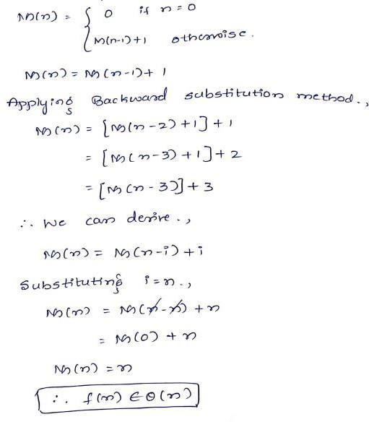
1. Factorial of a Number
ALGORITHM Fact(n)
if(n==0)
return 1;
else
return n*Fact(n-1);

Slide 71
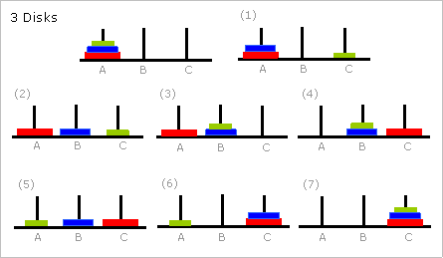
2. Tower of Hanoi
Step 1 − Move n-1 disks from source to aux Step 2 − Move nth disk from source to dest Step 3 − Move n-1 disks from aux to dest

Slide 72
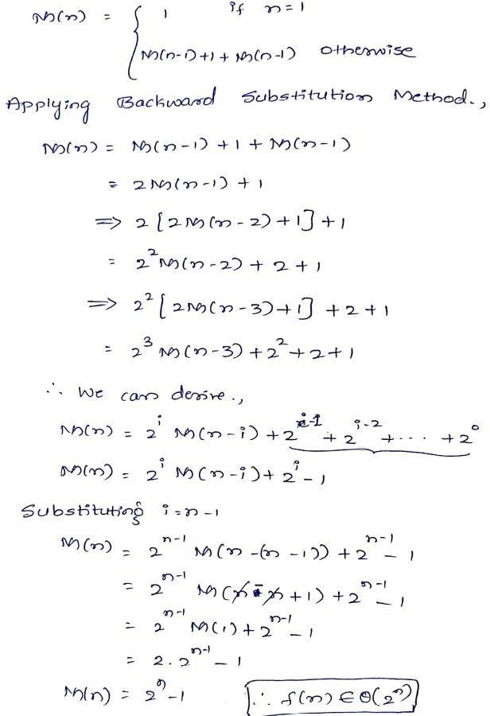
2. Tower of Hanoi
Algorithm Hanoi(n, source, dest, aux)
IF n == 1, THEN
move disk from source to dest ELSE
Hanoi(n - 1, source, aux, dest) move disk from source to dest Hanoi(n - 1, aux, dest, source)
END IF
// Step 1
// Step 2
// Step 3

Slide 73
Thank You

